Slide 1
Student Seminar - IDP
Presentation 1
Can Ersoy - 22.09.2026

Slide 2
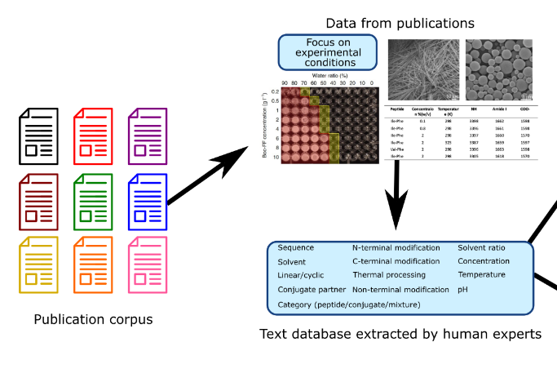
Project Background
LLM assisted evidence extraction from peptide self-assembly research
Based on project: https://github.com/lamm-mit/peptideminer [1]
Our focus is on 4-20 mer peptides
[1]
[1]: PeptideMiner: Learning the rules of peptide self-assembly through data mining with large language models, Zhenze Yang and Sarah K. Yorke and Tuomas P. J. Knowles and Markus J. Buehler, 2024
Notes:
Mostly based on a previous project from 2023 called PeptideMiner
PeptideMiner took a database called SapDB which had peptide experiment data from a set of papers.
They used llms to extract peptide self assembly experiment data automatically from same papers
The idea is to automate the process since it requires expert human knowledge and time to get this data manually.
Our project does something similar and focuses on 4-20 mer peptides

Slide 3
Roadmap
Golden Dataset Curation -> SAPdb [2], CPAD 2.0 [3], Cross-Beta [4], Amyload[5]
Paper Retrieval Pipeline
Extraction Pipeline
[2]: Mathur, Deepika, Harpreet Kaur, Anjali Dhall, Neelam Sharma, and Gajendra P. S. Raghava. “SAPdb: A Database of Short Peptides and the Corresponding Nanostructures Formed by Self-Assembly.” Computers in Biology and Medicine 133 (June 2021): 104391. https://doi.org/10.1016/j.compbiomed.2021.104391.
[3]: Rawat, Puneet, R. Prabakaran, R. Sakthivel, A. Mary Thangakani, Sandeep Kumar, and M. Michael Gromiha. “CPAD 2.0: A Repository of Curated Experimental Data on Aggregating Proteins and Peptides.” Amyloid 27, no. 2 (2020): 128–33. https://doi.org/10.1080/13506129.2020.1715363.
[4]: Gonay, Valentin, Michael P. Dunne, Javier Caceres‐Delpiano, and Andrey V. Kajava. “Developing Machine‐learning‐based Amyloidogenicity Predictors with Cross‐Beta DB.” Alzheimer’s & Dementia 21, no. 2 (2025): e14510. https://doi.org/10.1002/alz.14510.
[5]: Wozniak, Pawel P., and Malgorzata Kotulska. “AmyLoad: Website Dedicated to Amyloidogenic Protein Fragments.” Bioinformatics 31, no. 20 (2015): 3395–97. https://doi.org/10.1093/bioinformatics/btv375.
Notes:
Here you can see the overall steps on how our project is structured..
The main architecture is made up of two phases, paper retrieval and extraction.. The extraction part is where it aligns with peptide miner.
But for retrieval it differs from peptideminer which had a small amount (75~ papers) manually curated…
Up until now I have worked on creating a golden dataset that can later be used to validate that extraction part works.
In order to create this golden dataset I looked through different databases that included experiment data and their reference to papers
From which these experiments are from. Here you see some information. For this golden dataset the goal is not to just
Get 4-20 mer peptides though since extraction as a task should not be different int erms of the length of the peptide…
We also specifically include amyloid research which is something not included in peptideminer but still can be counted as self-assembly

Slide 4
Golden Dataset (1)
Columns: sequence, length, type, n_terminal, c_terminal, temperature, ph, peptide_concentration, solution, solvent, volume_ratio, incubation_period (in min), peptide/conjugate/mixture, conjugate_partner, linear/cyclic, detection_method, preparation_protocol, pmid, database
Currently 1182 entries (1017 from SAPdb/PeptideMiner, 102 from Cross-Beta, 59 from CPAD/Amyload, 4 from AmyLoad)
Pmid per entry to retrieve papers
Notes:
Here you can see the columns selected for the golden dataset entries… the idea is that not all databases provide same type of data so this subset of columns is a tradeoff of how much we could benefit from existing data which also makes sense and can potentially be used for further tasks like creating a prediction model….
Initially this golden dataset is made up of 1002 entries as you can see, most of it is from peptide miner since it provides clean and manually proven data…. Cross beta and cpad 2.0 mostly includes amyloid data which can still be extracted from the papers they reference

Slide 5
Golden Dataset (2)
: PeptideMiner/SapDB
: Cross-Beta DB
: CPAD/Amyload
sequence | length | type | n_terminal | c_terminal | temp | ph | peptide_concentration
FP | 2 | hydrogel | Chlorination | N-hexadecylamine | 25 °C | 7 | 132 mg/ml
ATAVSEWTEYKTADGKTFYYNNRTLE | 26 | amyloid | Free | Free | 37 °C | 7.0 | 100 µM
ISKLEYSNFSVRY | 13 | amyloid | Free | Free | 25 °C | 5.5 | 0.4 mg/mL
Notes:
Here an example directly from peptide miner to give a better idea… so we have 1002 entries like this that we can later use to validate if our extraction pipeline works correctly…
6,1030, 1130

Slide 6
Golden Dataset (3)
solution | solvent | volume_ratio | Incubation_period (min) | peptide/conjugate/mixture | conjugate_partner | linear/cyclic
H2O | Aqueous dispersion | 1 | 25 | Peptide | NP | Linear
Aqueous Buffer | 10 mM sodium phosphate, sodium azide 0.02%(v/v) | 1 | NP | Peptide | NP | Linear
Acetate | 50 mM Acetate; TFE (25%) | 1 | NP | Peptide | NP | Linear

Slide 7
Golden Dataset (4)
detection_method | preparation_protocol | pmid | database
Field Emission Scanning Electron Microscopy (FE - SEM) | The aqueous dispersions of the required amount of compound was slowly heated to dissolve the compounds in water … | 18052148 | peptideminer/sapdb
solid-state NMR, EM, ThT fluorescence | Purchased Second WW domain of the human CA150 (Sigma (St. Louis, MO)) | 17060612 | cross-beta
ThT | NP | 11799398 | CPAD; AmyLoad

Slide 8
Golden Dataset (5)
Assumptions for Cross-Beta and CPAD databases:
They can only map column type to amyloid/none
N_terminal and C_terminal are always assumed to be Free (?)
Peptide concentrations are given as is (no normalization to mg/ml)
Cross-Beta has as solution column 'Aqueous Buffer' if a buffer is present, CPAD has the buffer name if present else the same with Cross-Beta
Both are always assumed to be Linear
Both are always assumed to be Peptide (hence no conjugate_partner)
CPAD has for solvent column the following concatenation of values: [Conc] [Buffer]; [Ion Conc] [Ion]; [Additives]

Slide 9
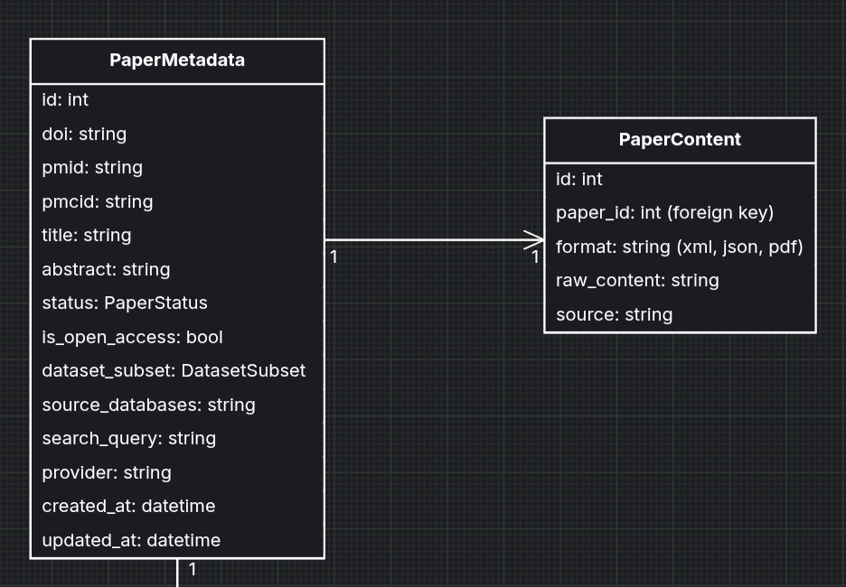
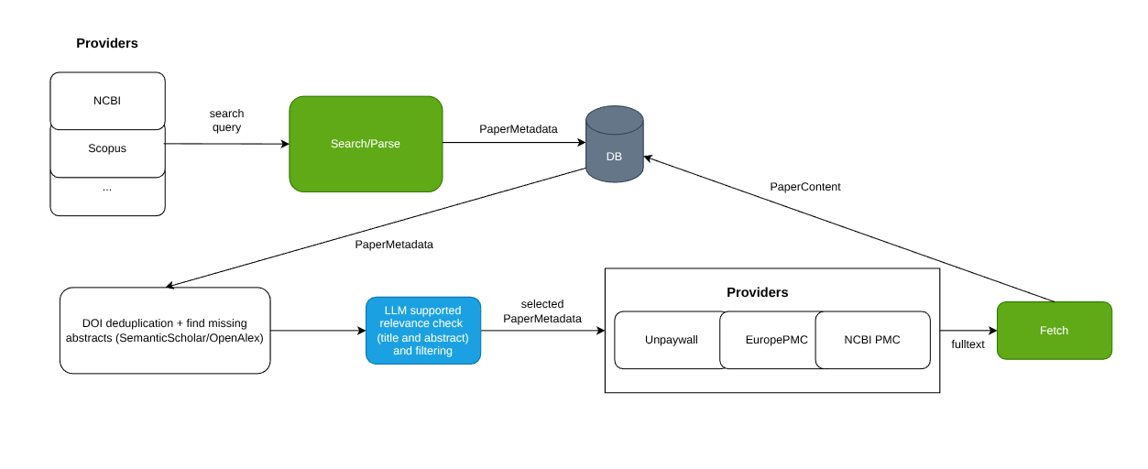
Paper Retrieval
Notes:
That brings us to the paper retrieval pipeline…. You can see an initial system diagram of the retrieval phase… as you can see nearly every part is self contained and uses a single database to work.. This allowed up until now a simpler development process…
It works by using different providers to retrieve the metadata (title, abstract) of papers given a query which I will talk about in a second… we also have a phase here where we pass the title and abstract of found papers to an llm for it to figure out if it makes sense for us to retrieve the fulltext… Then we would use same or different providers according to availability to retrieve fulltext of papers in xml or pdf format and store them inside the db.. These can then later be used in extraction phase which I wont go into today but will come in later weeks…

Slide 10
Paper Search (1)
Different providers require separate queries but general idea is the same:
NCBI: (tetrapeptide[tiab] OR pentapeptide[tiab] … ) AND (nanostructure[tiab] OR nanotube[tiab] …)
Scopus: TITLE-ABS-KEY(tetrapeptide OR pentapeptide …) AND TITLE-ABS-KEY(nanostructure OR nanotube OR nanofiber …)
Notes:
Some more detail about paper search, we use the following queries.. The exact syntax is different per provider but the idea is same… every peptide length from 4 to 20 is mapped to a self assembly stcutreu name… this should catch a good amount of papers for now I will give some numbers… this can also be updated later on if we find out the number of papers is not sufficient… you can also see we use a tiab filter which makes it so that we only search these keywords in title and abstract… most providers dont support fulltext search and it is also misleading since I have seen quite a few cases where it just mapped to a title of a reference since that is also included in the fulltext….

Slide 11
Paper Search (2)
Additional requirements for query:
English only: higher extraction accuracy
No review article: should increase chance of experiment data being available
Open access: licensing issues
Results (as of 29.08.2026):
Without add. Requirements: With add. requirements:
NCBI: 533 papers 187 papers
Scopu: 1608 papers 560 papers
Notes:
There is also additional requirements on what papers we query… it should be in english, should ideally not be a review paper (which probably doesnt include any experiment data) and should be open access so we can pass the fulltext into an llm without any licensing issues… you can see we found … papers

Slide 12
Paper Search (3)
After doi normalization and deduplication (as of 18.09.2026) there are 574 unique papers from ncbi+scopus.
553 have non-empty abstract (after abstract retrieval run)
417 also have a pmcid (doesn’t necessarily mean there is a fulltext on pmc but a higher chance)

Slide 13
Paper Relevance Check (1)
SYSTEM_PROMPT = {...} Be careful not to discard papers that do not explicitly state full experimental details in the abstract but hint at experimental work. It is better to include a borderline paper (marking as relevant with lower confidence) than to mistakenly discard a paper containing experimental data.
USER_PROMPT = Here is the title and abstract of a paper:
Title: {title}
Abstract: {abstract}
OUTPUT
detected_clues: JSON-encoded array or text list of detected clues
explanation: Justification focusing on experimental conditions
is_relevant: True if experimental self-assembly data is reported or hinted at
confidence: Confidence score between 0.0 and 1.0
Notes:
Than a little bit about the paper relevance check I mentioned…. The idea is that we pass the title and abstract of papers to an llm and ask it to find some clues about experiment data and make a decision on whether it thinks the paper would be relevant for our research… you can see the first version of the system prompt passed here which gave the following results

Slide 14
Paper Relevance Check (2)
Golden Dataset Results (116 out of 157 papers tested):
Gemini 3.5 Flash Lite - 115 relevant - 1 discard
Gemma 31b - 115 relevant - 1 discard (same paper with gemini 3.5 flash lite)
Llama 3.2 3b - 112 relevant - 4 discard (also includes same paper as the two above)
System Prompt Specific Section:
You are an expert in scientific paper reading and computational biology.
Your task is to determine whether a given scientific paper is relevant for an information extraction pipeline on peptide self-assembly/amyloid research based only on its title and abstract.
You must determine if the paper reports experimental self-assembly or nanostructure formation of short peptides (e.g., nanofibers, hydrogels, nanotubes, vesicles, organogels, nanospheres, amyloid fibrils) along with experimental conditions (e.g., pH, solvent, concentration, temperature, detection methods).
Notes:
For now only golden dataset papers (119) were screened for relevance… the idea is that all these papers should be marked as relevant since we know they include experiment data…. With the system prompt I showed, these were the results…

Slide 15
Paper Relevance Check (3)
Scraped Papers - (100 out of 574) papers - System Prompt v1
Gemini 3.5 Flash Lite - 78 relevant - 22 discard
System Prompt Specific Section:
You are an expert in scientific paper reading and computational biology.
Your task is to determine whether a given scientific paper is relevant for an information extraction pipeline on 4-20mer peptide self-assembly research based only on its title and abstract.
You must determine if the paper reports experimental self-assembly or nanostructure formation of short peptides (e.g., nanofibers, hydrogels, nanotubes, vesicles, organogels, nanospheres, amyloid fibrils) along with experimental conditions (e.g., pH, solvent, concentration, temperature, detection methods).
Notes:
Then with an updated system prompt the results were better since we don’t want it to just check 4-20 mer papers for the golden dataset at least….

Slide 16
Paper Relevance Check (4)
Scraped Papers - (100 out of 574) papers - System Prompt v2
Gemini 3.5 Flash Lite - 75 relevant - 25 discard
System Prompt Specific Section:
You are an expert in scientific paper reading and peptide research.
Your task is to determine whether a given scientific paper is relevant for an information extraction pipeline on 4-20mer peptide self-assembly/amyloid research based only on its title and abstract. Based on your decision, fulltext of the paper will be retrieved.
You must determine if the fulltext of the paper likely reports experimental self-assembly or nanostructure formation of short peptides (e.g., nanofibers, hydrogels, nanotubes, vesicles, organogels, nanospheres, amyloid fibrils ...) along with experimental conditions (e.g., pH, solvent, concentration, temperature, detection methods ...). Keep in mind, most of the time for longer peptides, oligopeptide naming system (e.g. dodecapeptide for 12-mer) is not provided and peptides might have special names.

Slide 17
Paper Relevance Check (5)
Scraped Papers - (100 out of 574) papers - System Prompt v3
Gemini 3.5 Flash Lite - 76 relevant - 24 discard
System Prompt Specific Section:
You are an expert in scientific paper reading and biophysics specializing in peptide self-assembly and amyloid aggregation.Your task is to determine whether a given scientific paper is relevant for an information extraction pipeline on 4-20mer peptide self-assembly research based only on its title and abstract. The project extracts experimental records for short peptides (roughly 4-20 residues, including canonical sequences, capped/modified peptides, and amyloidogenic fragments), capturing self-assembly or phase behavior (e.g., nanofibers, hydrogels, nanotubes, nanospheres, amyloid fibrils, ribbons, vesicles, or amorphous aggregates) and associated experimental conditions (e.g., pH, concentration, solvent/buffer, temperature, characterization methods).
Because abstracts are dense summaries that often omit detailed experimental parameters:
- Assume a paper is RELEVANT (`is_relevant: True`) if it reports or strongly implies original experimental (wet-lab) work on peptide self-assembly, aggregation, or amyloid formation.
- Do NOT require full quantitative experimental conditions (such as exact pH or concentration values) or full sequence lengths to be explicitly stated in the abstract; hints of physical characterization (e.g., microscopy, spectroscopy, gelation, kinetic assays) are sufficient.
- Only mark `is_relevant: False` if the paper is unambiguously out of scope: purely theoretical/computational studies without experimental validation, general review articles/editorials, or studies exclusively on intact, full-length proteins without isolated peptide fragments.
- When in doubt, prioritize recall and classify borderline papers as relevant with a lower confidence score.

Slide 18
Paper Fulltext Fetch
Currently retrieval is only possible from pmc (PubMed Central / NCBI)
There must be a pmcid provided (can be retrieved via pmid from NCBI API). This doesn’t guarantee full text but is necessary.
Retrieval Counts (as of 20.09)
Golden Dataset: 65/157
Scraped: 385/574

Slide 19
Summary
Golden dataset includes 1182 entries and 157 unique papers
Paper search currently supports NCBI and Scopus APIs
Initial search across NCBI and Scopus returned 574 unique (by doi) papers
For 553 of these papers, abstract could be retrieved either directly in the initial request or via abstract completion step via OpenAlex/SemanticScholar
Full Text fetch is currently supported only via PubMed Central (PMC)

Slide 20
Next Steps
Start with the extraction pipeline
Improve/complete retrieval alongside

